Slide 1
Welcome Reception 2023

Slide 3
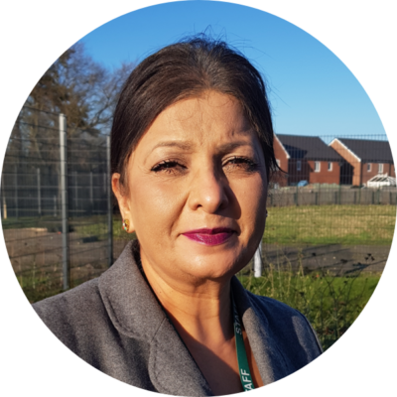
Some familiar faces
Principal Suki Powar
Administrator Claire Halford
SENCo Sarah Harris
Year Group | Teacher | Associate Staff
Nursery | Sarah Harris Cath Hood | Claire Nero TBC
Reception | Johnathan Crockett | Ilona Johnson

Slide 4
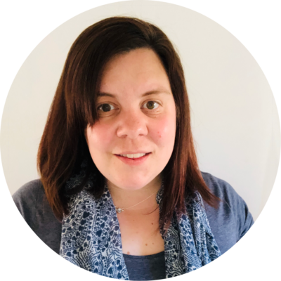
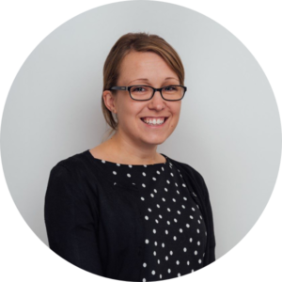
Designated Safeguarding Leads
Principal
DSL
Mrs Powar
SENCo
Nursery Teacher
DSL
Miss Harris
EYFS Lead
Reception Teacher
DDSL
Mr Crockett
KS1 Lead
Year 2 Teacher
DDSL
Miss Hodges
TGPA Meon Vale ensures that all children learn in a safe, caring and enriching environment. Children are taught and offered support to keep themselves safe, to develop positive and healthy relationships and to avoid situations where they might be at risk, including being exploited by others.

Slide 5
What is the EYFS?
We follow the EYFS Statutory Framework.
There are 17 Early Learning Goals which the children work towards
throughout Nursery and Reception.
Prime Areas
Communication and Language
Listening, Attention and Understanding
Speaking
Personal Social and
Emotional Development
Self Regulation
Managing Self
Building Relationships
Physical Development
Gross Motor Skills
Fine Motor Skills

Slide 6
Specific Areas
Literacy
Word Reading
Comprehension
Writing
Mathematics
Number
Numerical Patterns
Understanding the world
Past and Present
People, Culture and Communities
The Natural World
Expressive Art and Design
Creating with Materials
Being Imaginative

Slide 7
The Creative Curriculum
Sparkle and Shine
Superhero Me
Incredible Eggs
What topics will be covered over the academic year?
Awesome Oceans
The Great Outdoors
Once Upon A Time…

Slide 8
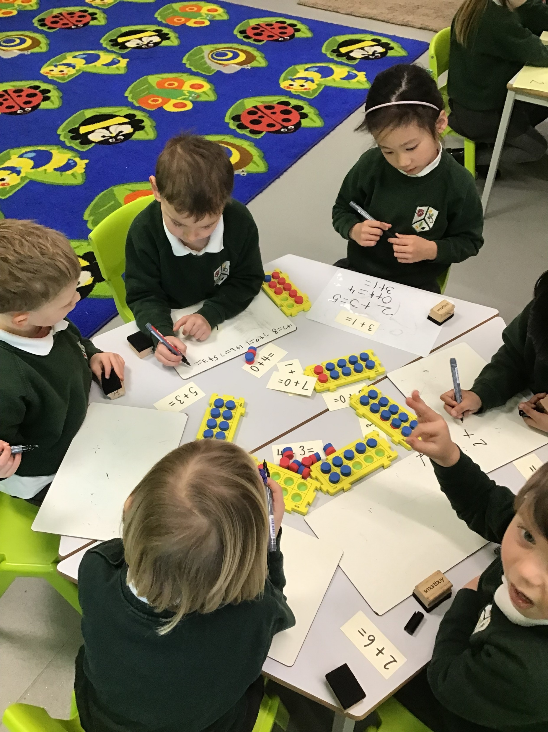
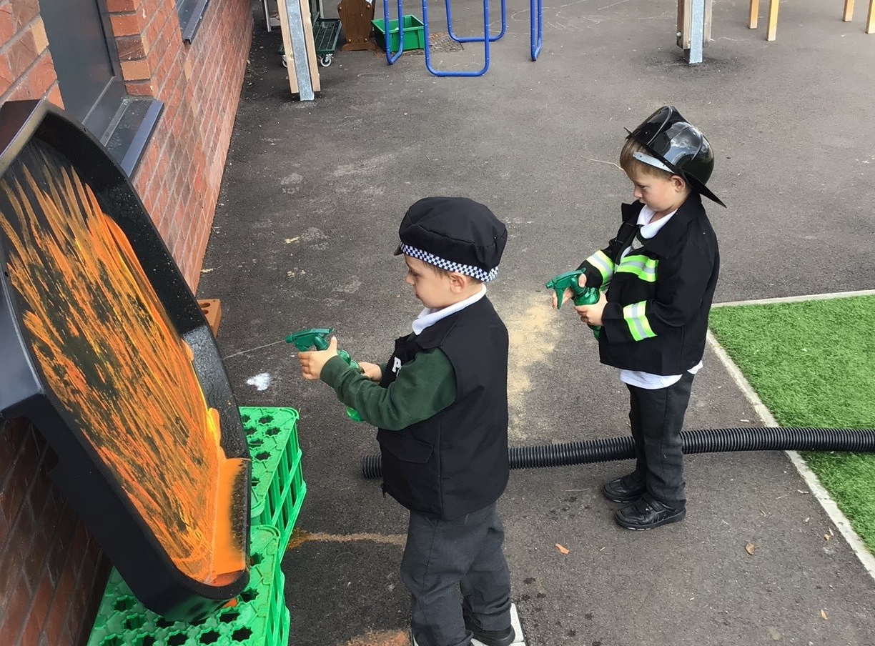
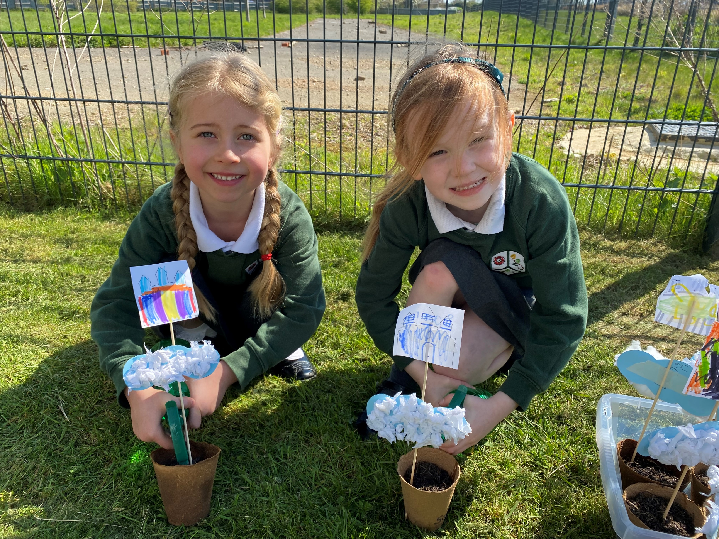
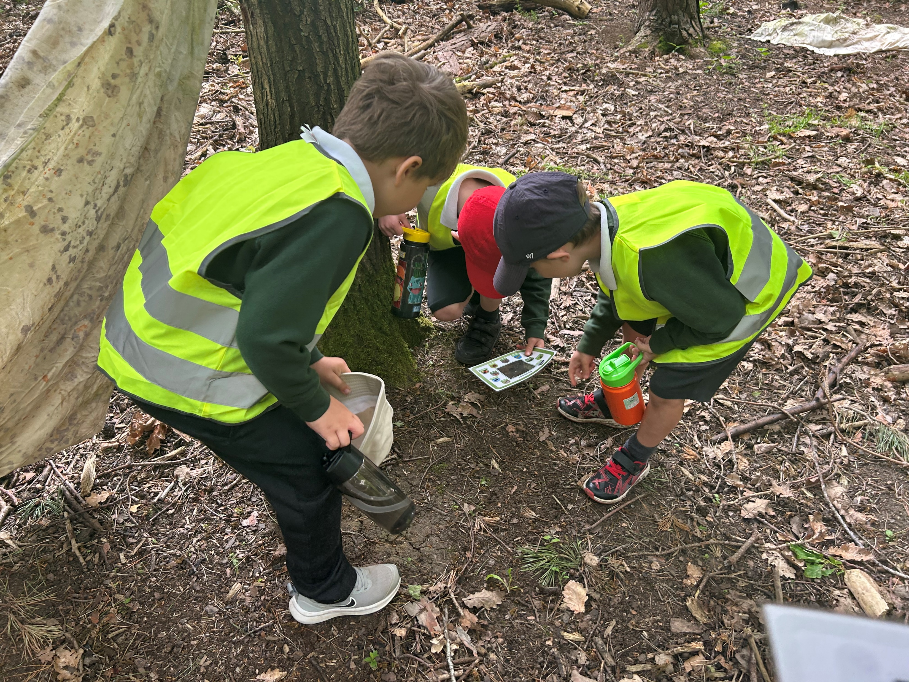
A typical day in Year R
Time | Activity
8:30am | Gates open
8:45am | School day begins
11:45am - 12:45pm | Lunchtime
15:15pm | School day ends
Daily Adult Directed sessions
Maths, Literacy, Phonics
Weekly PE, Music and PSHE
Child Initiated Learning

Slide 9
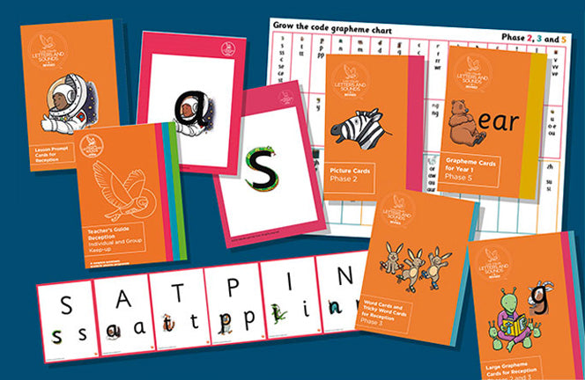
Phonics
Daily direct whole class teaching
Secure, systematic progression in phonics learning
Providing repeated practice
Early identification of children at risk of falling behind, linked to the provision of effective keep-up support.
Application of phonics using matched decodable books- Read 3 times a week at school

Slide 10
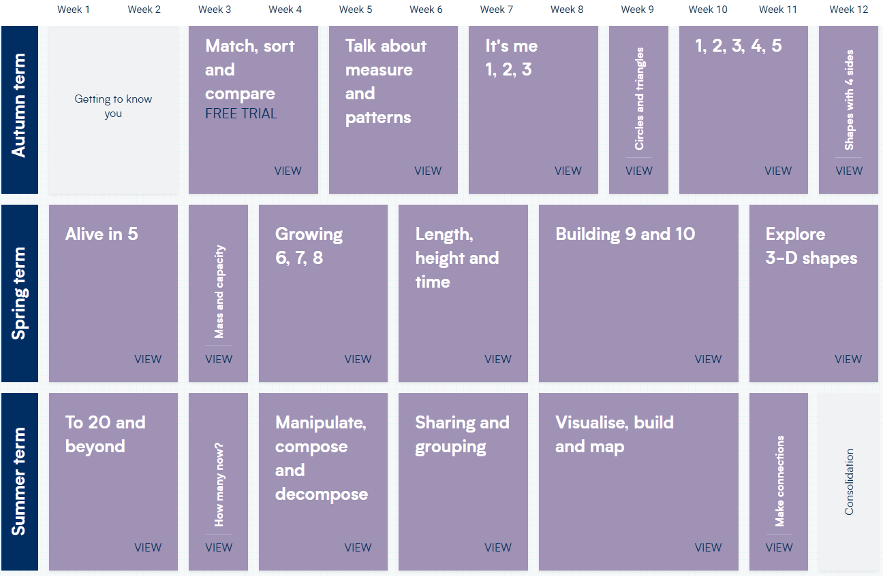
Maths

Slide 11
Uniform
GIRLS
Winter uniform:
Bottle green sweatshirts with school logo
White polo shirt with school logo
Grey school pinafores/skirts
Grey tights
Black shoes
Summer uniform
Green striped dress
White socks
Black shoes (no sandals)
BOYS
Winter uniform
Bottle green sweatshirts with school logo
White polo shirt with school logo
Grey school trousers
Grey socks
Black shoes
Summer uniform
White polo shirt
Grey shorts
Grey socks Black shoes (no sandals)
Uniform can be ordered from: www.schoolwearsolutions.com Deadline to order: 31st July 2023
We also have a small selection of ‘pre-loved’ uniform available.

Slide 12
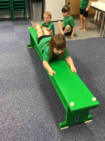
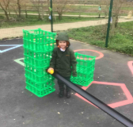
P.E. KIT
Black slip-on pumps
Green t-shirt
Black shorts
A named drawstring bag or school logo backpack.
PLEASE NAME LABEL ALL COATS, SHOES AND ALL ITEMS OF SCHOOL UNIFORM INCLUDING P.E. KIT
Ensure your child has a coat that matches the weather. In winter it is vital that they bring a waterproof coat with a hood which they are able to fasten themselves.
In summer they must bring a sun hat and have sun cream applied before school.

Slide 13
What your child needs to bring to school every day
Book bag – your child must bring this daily. Please note, once reading starts reading books and diaries must remain in book bag and be brought in each day.
A named water bottle for the classroom. Please only send still drinking water.
A suitable waterproof coat with a hood.
Lunch box – If your child is bringing a packed lunch then this kept in a designated area.
P.E. bag containing sports kit – as listed previously. The bag will be sent home at the end of each half term to be washed and returned the following term. During term time these will remain on your child’s peg.
Named wellies.

Slide 14
Lunchtimes
You choose from a selection of three meals per day in advance so you can ensure your child has something you know they will enjoy, otherwise they can bring their own healthy packed lunch.
Please check the menu each week to see what is coming up!
Packed Lunches
Snacks
Children must have a healthy packed lunch
This can include sandwiches, wraps, crackers, rice cakes, pasta, yoghurts, fruit, carrot sticks, cold chicken bites, crisps, Babybel, dunkers, carton of drink- not fizzy.
We are also a nut free school!
Children are offered a free fruit or vegetable snack as part of the funded ‘School Fruit and Vegetable Scheme’.
Children also receive free milk until their 5th birthday.

Slide 15
Partnership with parents
Contacting the school
Email: office@meonvale.tgacademy.org.uk Tel: 01789 721 060
Open door policy- please be mindful that this is a period to welcome children into school so you may need to arrange an appointment at the end of the day
Reading records- to record your child’s reading at home and any daily messages
MCAS app- My Child At School
There will be lots of other opportunities for parental support including phonics and maths sessions to support learning at home.

Slide 16
Voluntary Contributions
Within EYFS, our curriculum involves a lot of everyday resources to make learning hands on, relevant and fun.
As staff, we make our own playdough, use shaving foam and rice for sensory learning, and do lots of cooking and food technology.
To support us in taking out these activities, we have created a Voluntary Contributions system.
£1 per week or £10 per term

Slide 17
Attendance
Absences Procedure
If your child is ill and unable to attend school, a parent/carer must telephone or email first thing in the morning, on every day of absence.
Medical -If a pupil needs to attend a medical appointment, a letter or appointment slip must be brought in from home.
Religious Observations and Funerals -A leave of absence form, which can be obtained from Reception, should be completed and returned to Reception.
Family Holiday -Leave will not be granted for family holidays unless under exceptional circumstances. Requests for leave of absence must be made on the Academy’s official leave of absence form, which can be obtained from Reception

Slide 18
Term Dates 2023/2024
Autumn Term
Spring Term
Summer Term
Inset | Friday 1st September 2023
Inset | Monday 4th September 2023
Term starts | Tuesday 5th September 2023
Trust inset | Friday 6th October 2023
Half term | Monday 30th October 2023 to Friday 3rd November 2023
Term ends | Friday 22nd December 2023
Inset | Monday 8th January 2024
Term starts | Tuesday 9th January 2024
Trust inset | Monday 29th January 2024
Half term | Monday 12th February 2024 to Friday 16th February 2024
Term ends | Friday 22nd March 2024
Term starts | Monday 8th April 2024
Half term | Monday 27th May 2024 to Friday 31st May 2024
Trust inset | Friday 28th June 2024
Term ends | Thursday 18th July 2024
Inset | Friday 19th July 2024
Bank Holidays on Monday 6 May 2024 and Monday 27 May 2024
On INSET days the Academy is closed for staff training

Slide 19
Reception Transition September 2023
 | Current TGPA Meon Vale Nursery | New to TGPA Meon Vale
Monday | Closed for Inset Day | Closed for Inset Day
Tuesday | 8:45am – 3:15pm | 8:45am – 11:30am
Wednesday | 8:45am – 3:15pm | 8:45am – 11:30am
Thursday | 8:45am – 3:15pm | 8:45am – 1pm (Stay for lunch)
Friday | 8:45am – 3:15pm | 8:45am – 3:15pm

Slide 20
Additional Information needed
Home School Agreement
Collection Arrangements
Parental Permissions
Wrap around care
Breakfast club opens at 7:30am- currently £4.50
Afterschool club 3:15pm – 5:30pm- currently £10.50
*Prices will increase in September 2023
Please ensure that you let us know of any medical or SEN needs that your child has prior to starting in September. We want the smoothest transition possible for your child at school.

Slide 21
Any questions?

