Slide 1


Slide 2
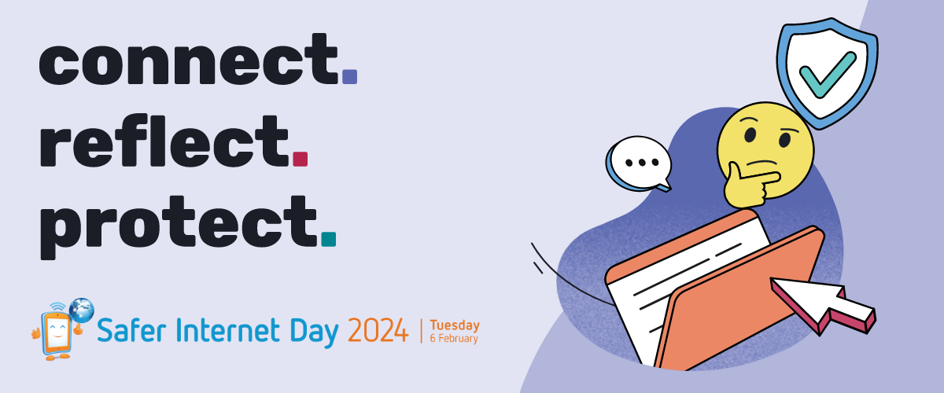

Slide 3

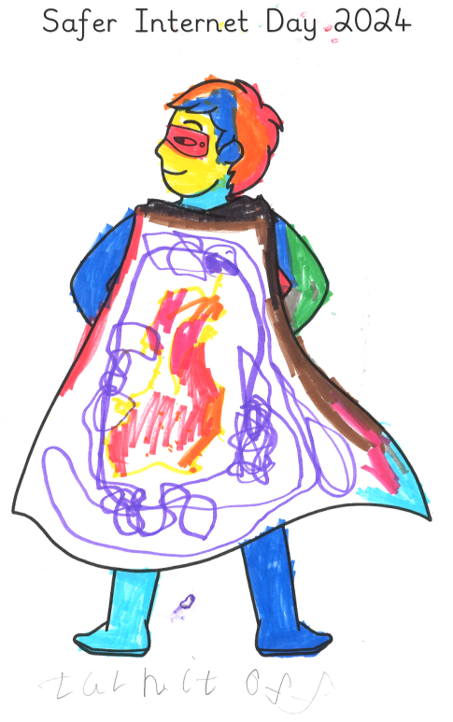
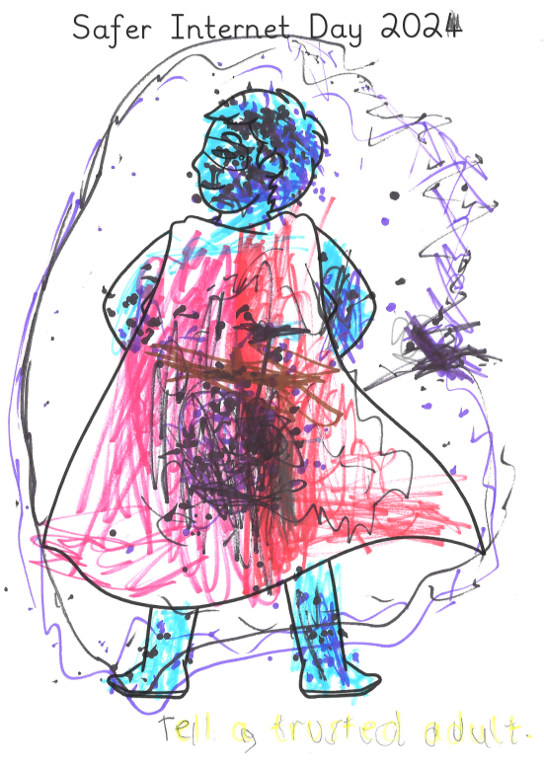
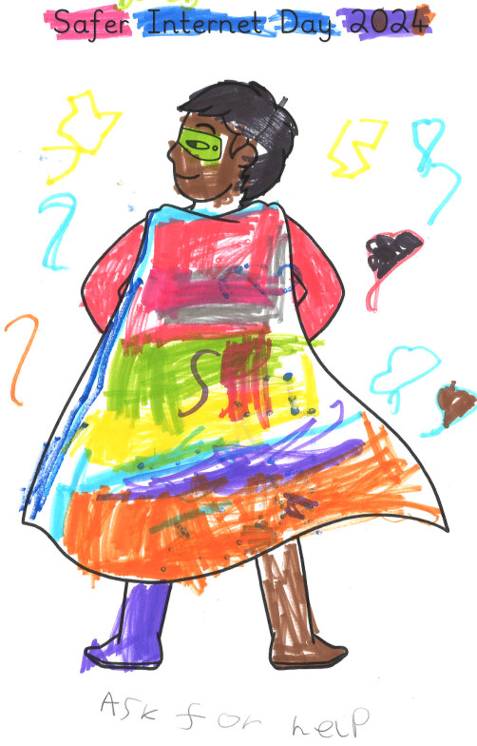
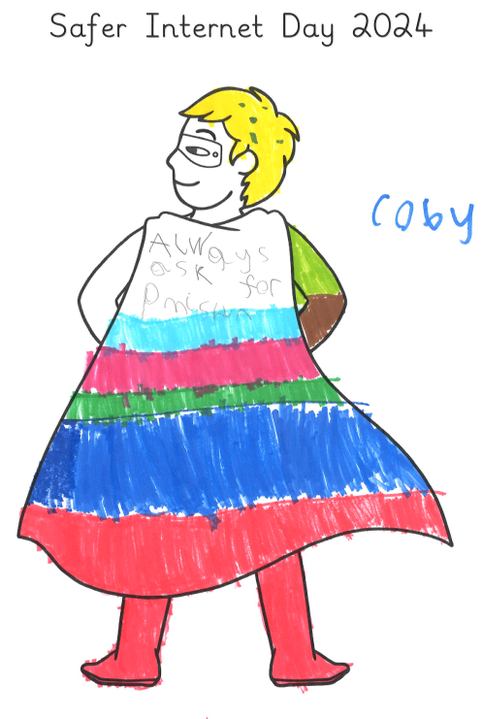

Year 1 – Willow
Ask for help.
Always ask for permission.
Turn it off.
Tell a trusted adult.
Willow Class mind mapped ways that we can keep ourselves stay safe online. We then designed 'safer internet superheroes' - these superheroes are in charge of helping children stay safe by remembering one of our top tips.

Slide 4
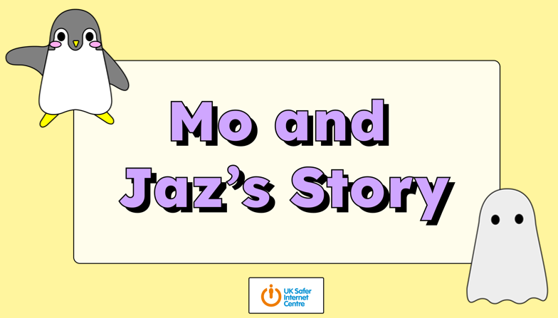
We should tell a grownup at home or a teacher at school if we see something online that makes us feel worried.
Year 2 – Birch
Mo and Jaz had a funny feeling in their tummy when they saw something that they didn’t like.
The Dad changed the safety settings on Mo and Jaz’s tablet to stop them from seeing videos that made them feel worried and upset.
Mo and Jaz stopped watching the video and asked their Dad for help.
We learnt to ‘STOP! CLOSE! TELL!’
Birch Class read a story about how to stay safe online. It was about Mo and Jaz who like watching videos online. When they were watching a video about penguins, another video started that they didn’t like.
Birch Class learnt about how different things we see online can make us feel and what to do if we see something that makes us feel worried, scared or upset online.

Slide 5
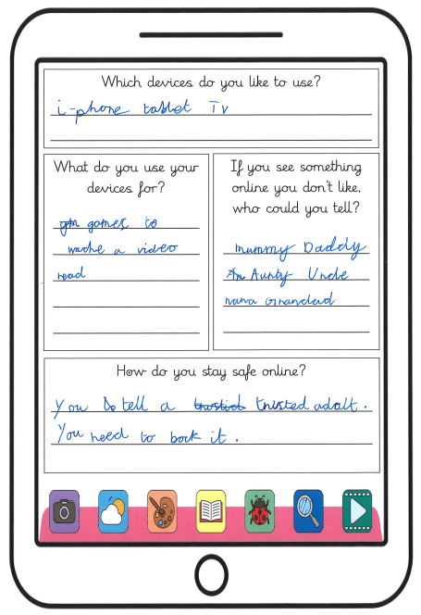
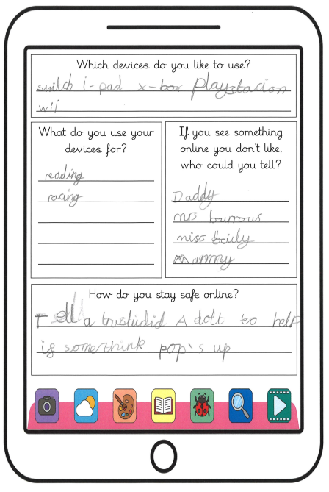
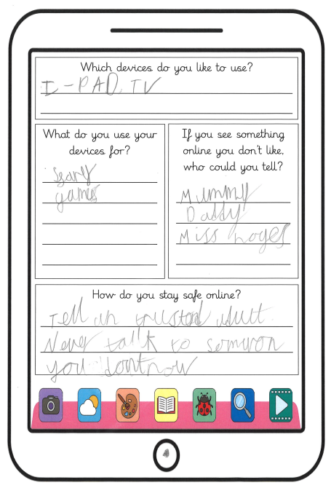
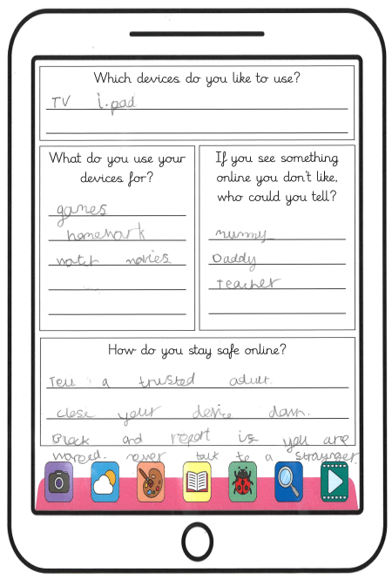
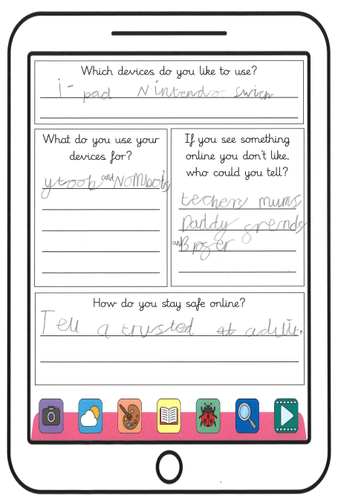
Year 2 – Birch
I stay safe by telling my grownups at home if I see something online that I am not sure about.
I ask my parents’ permission before I download anything.
I only play on games that are appropriate for my age.
I use my tablet to go on Mathletics and Numbots.
My teachers help me stay safe online.

Slide 6
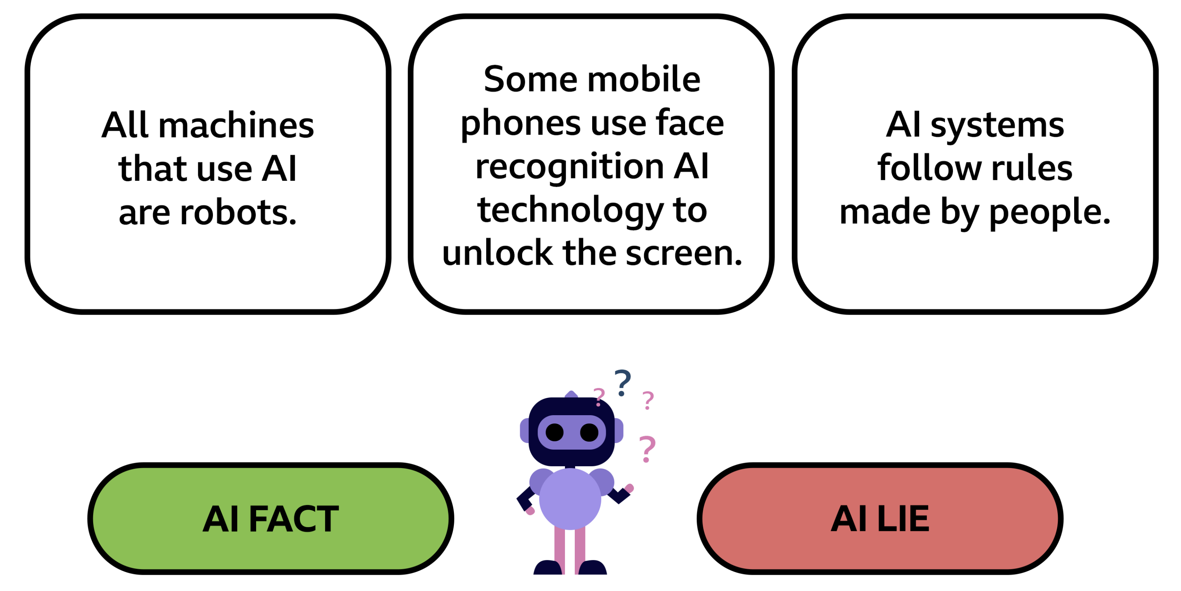
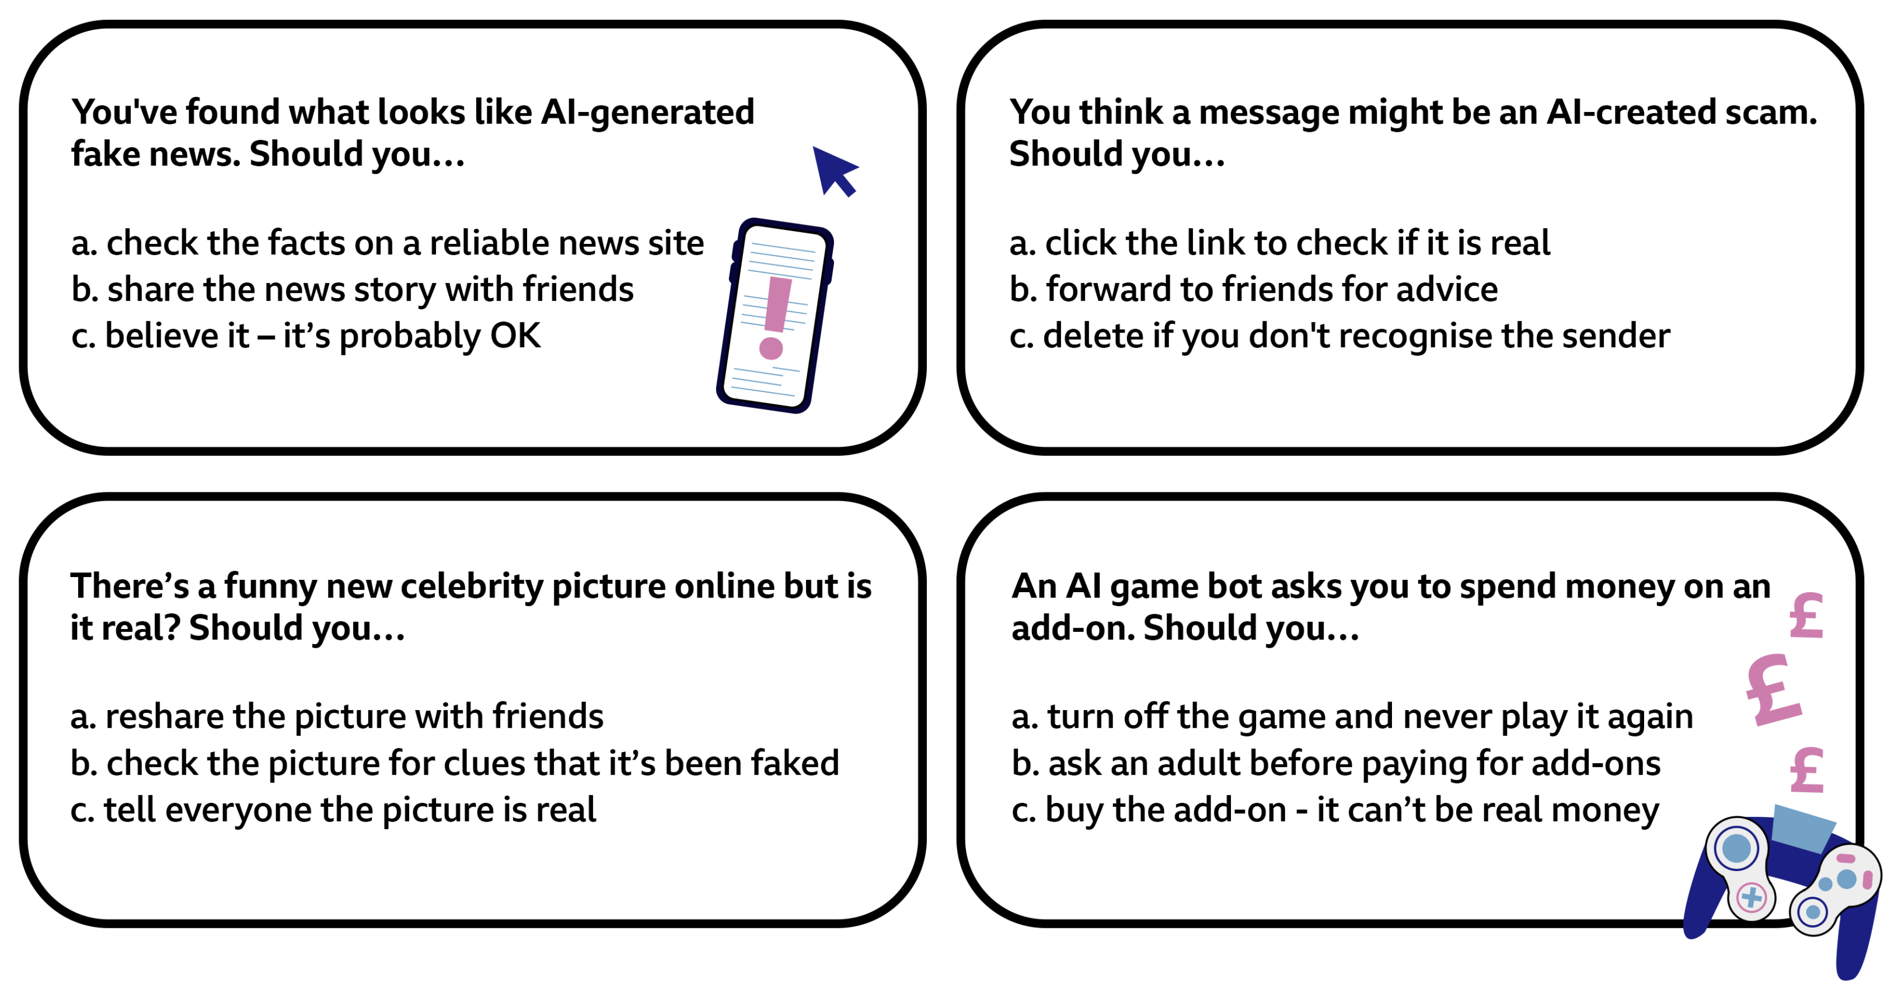
Year 3 – Pine
Pine Class became digital detectives and explored the exciting world of Artificial Intelligence in the Safer Internet Day 2024 Live Lesson.
Know the importance of keeping personal information private.
Understand the impact of positive and negative content online on mental and physical wellbeing.
Identify a range of ways to report concerns about content and contact.
Be aware of how to keep themselves safe and secure.
Use digital technologies to search, access and retrieve information and be aware that not all of this information will be credible.
Identify and assess risks and take steps to reduce them.
Know how to ask for help when they need it from people they trust.
Explain the importance of accurate and reliable data to ensure a desired outcome.
We participated in a number of activities where we had to decide if something was fact or a lie.
We had to make a decision about the choices we would make.

Slide 7
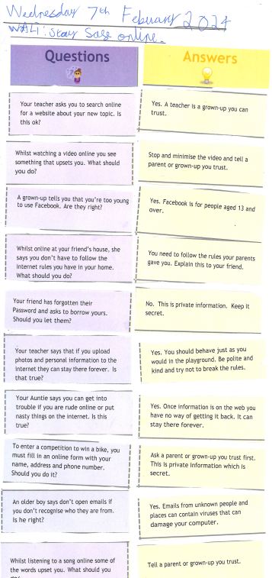
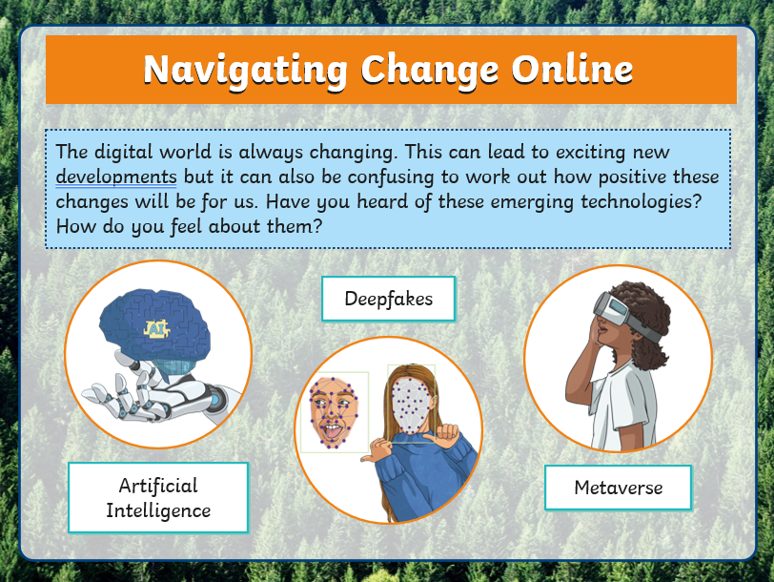
Year 4 – Spruce
Spruce Class looked at the ways that technology is changing and how emergent technology can be worrying sometimes if you don't feel confident using it.
Don't let other people use your password. This is private and should not be shared.
If you see something online you don't like, minimise the page and tell someone you trust.
The children discussed what to do if they feel unsafe online and who they can talk to about any concerns they have. They also talked about and completed a task about what they can do to keep themselves and their information safe.

